Slide 1

Natural and Revealed
Knowledge of God
Catechism Questions 1-5
January 14, 2018

Slide 2
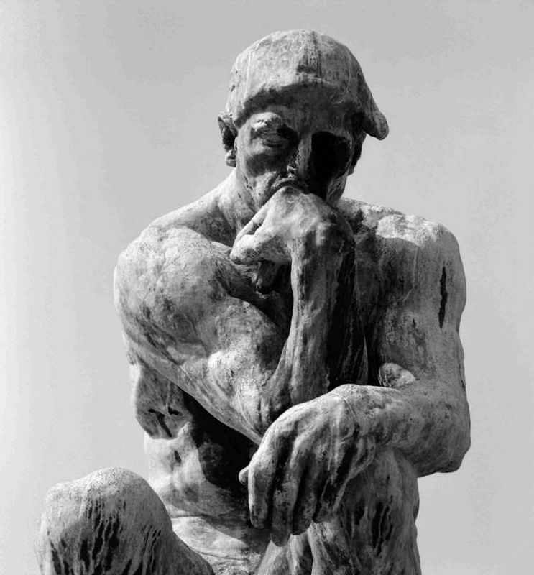
What does my natural knowledge tell me about God?

Slide 3
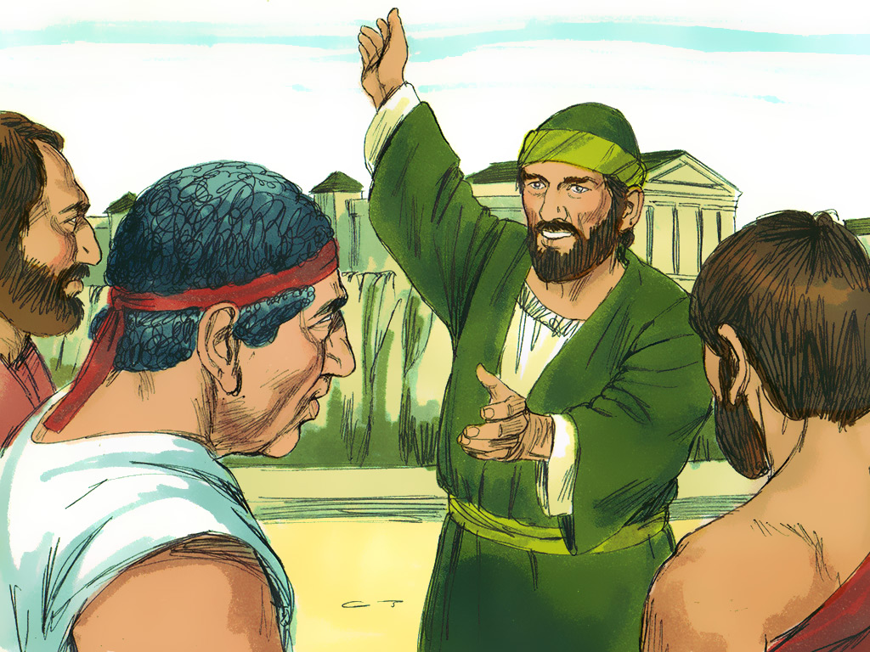
Paul Introduces The Unknown God
Acts
17:16-24

Slide 4
What did the Athenians already know about God?
He exists and is worthy of worship.
What did the Athenians not know about God?
Doesn’t live in temples or much else about him.

Slide 5
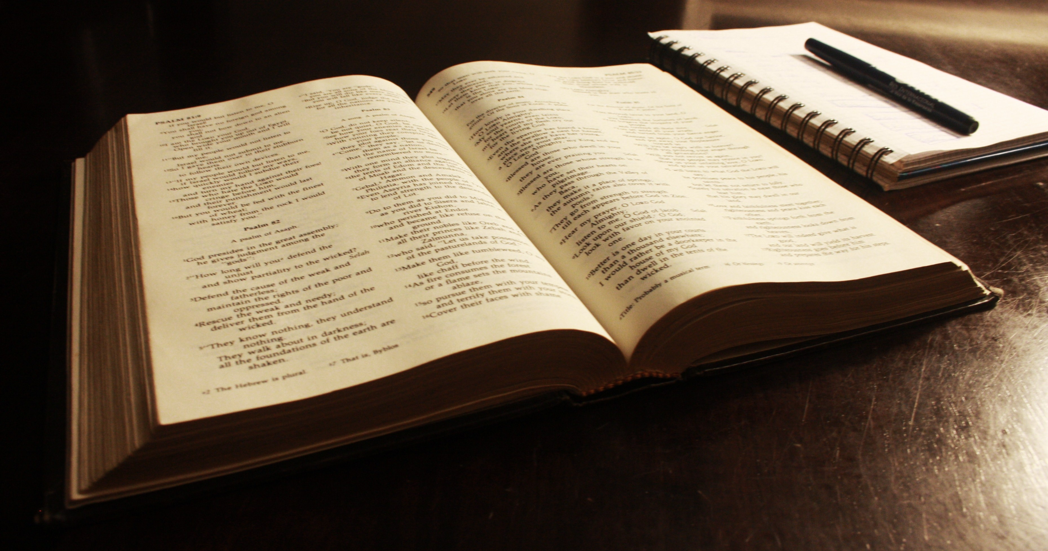
Psalm 19:1-4

Slide 6
What tells us that there is a God?
Nature tells us that there is a God.

Slide 7
Paul Introduces The Unknown God
Acts
17:16-24

Slide 8
Romans 2:14-16

Slide 9
How do all people naturally know there is a God?
By looking at nature and the existence of their conscience. (Natural Knowledge)

Slide 10
Paul Introduces The Unknown God
Acts
17:16-24

Slide 11
John 14:6; 20:31

Slide 12
What is the Bible’s central message?
Telling us about our Savior Jesus.

Slide 13
Paul Introduces The Unknown God
Acts
17:16-24

Slide 14
1 Corinthians 2:7-10a

Slide 15
Why do people need to know about
the Bible’s central message?
It is only in Bible we find out about our salvation from sin. (Revealed Knowledge)

Slide 16
Paul Introduces The Unknown God
Acts
17:16-24

Slide 17
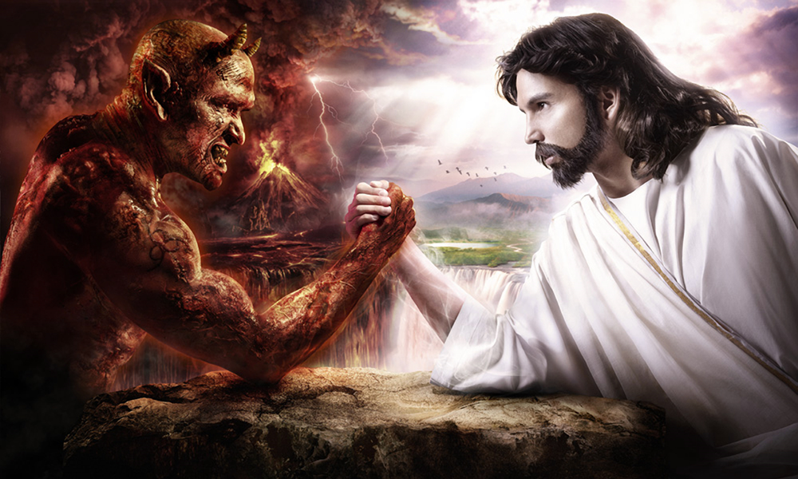
Only a fool can be an atheist.
People worship idols in other countries because their consciences bother them.

Slide 18
What does my natural knowledge tell me about God?
It tells me that there is a God who will judge me guilty for my sins. It is the Bible’s revealed knowledge that I find my salvation in Jesus.

Slide 19
Natural and Revealed
Knowledge of God
Catechism Questions 1-5
January 14, 2018

Slide 20


